Slide 1
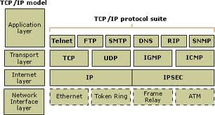
TCP / IP

Slide 2
TCP / IP
Transmission Control Protocol (TCP)
and
Internet Protocol (IP)

Slide 3
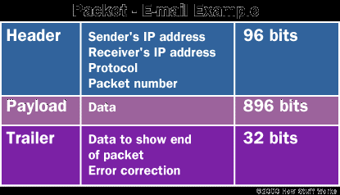
TCP / IP
TCP/IP provides end-to-end connectivity specifying how data should be formatted, addressed, transmitted, routed and received at the destination

Slide 4
IPV 4
32 bit Addressing - written in the dot-decimal notation, which consists of four octets of the address expressed individually in decimal and separated by periods.
242.123.56.21
32-bit (four-byte) addresses = 4,294,967,296
Known to be limited since '80s
IPv4 address exhaustion = 2/3/11
Development of IPv6 in the ‘90s - in commercial deployment since ‘06.

Slide 5
IP Addresses
IP addresses consist of four octets (8-bits), each octet between 0 and 255.
Examples include:
208.32.56.232
192.168.3.54
12.5.24.2
127.0.0.1

Slide 6
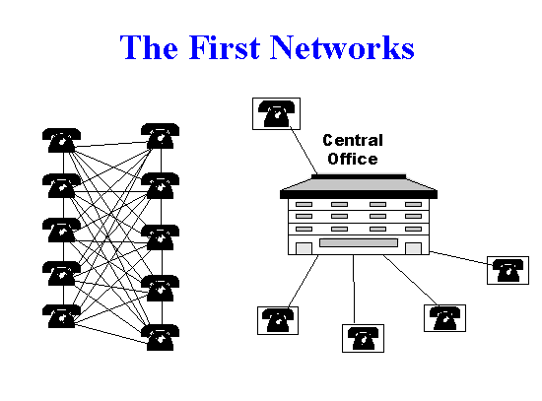
There must be a properly configured IP address and compatible subnet mask.
To connect to the Internet, you need a gateway address and DNS server address.

Slide 7
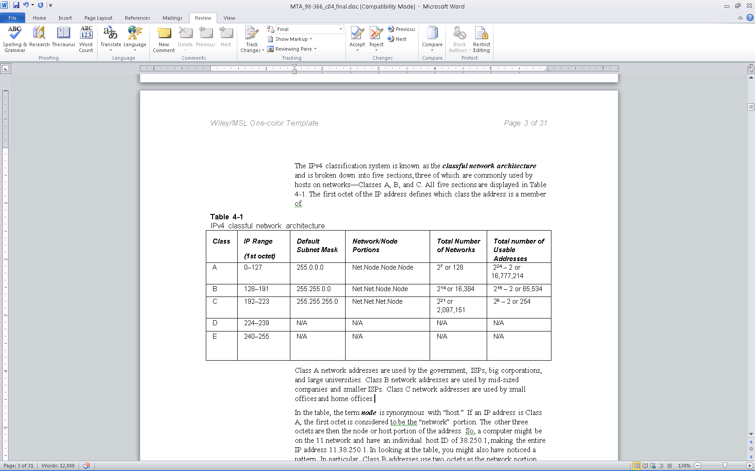
Classful Network Architecture
Notes:
The IPv4 classification system is known as the classful network architecture and is broken down into five sections, three of which are commonly used by hosts on networks—Classes A, B, and C.
The term node is synonymous with “host.”
If an IP address is Class A, the first octet is considered to be the “network” portion.
The subnet mask is what differentiates between the Network and the Host or Node.
Usable addresses Are the bit number -2. All 0’s is the unicast address and all 1’s is the broadcast address.
IP is in base 10, a base 10 representation of binary
Class D is used for what is known as multicasting – transmitting data to multiple computers or routers
Class E was reserved for future use, but given way to IPv6

Slide 8
Usable Addresses
Usable addresses is always going to be two less than the mathematical amount.
The first and last addresses can’t be used.
The 0 (in binary) for the host bits defines the entire network.
172.24.3.0
The 1s (in binary) defines the known as the broadcast address,
172.24.3.255

Slide 9
The range for Class A is 0–127.
The 127 network number isn’t used by hosts as a logical IP address. Instead, this network is used for loopback IP addresses, which allow for testing.
A way for you to test your own machine
127.0.0.1

Slide 10
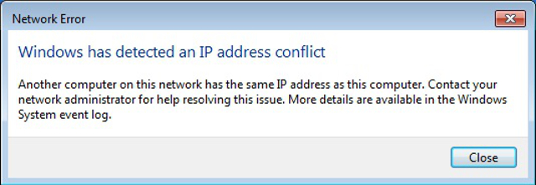
IP Conflict
2 devices have been assigned same addresses – DHCP
Static IP Addresses

Slide 11
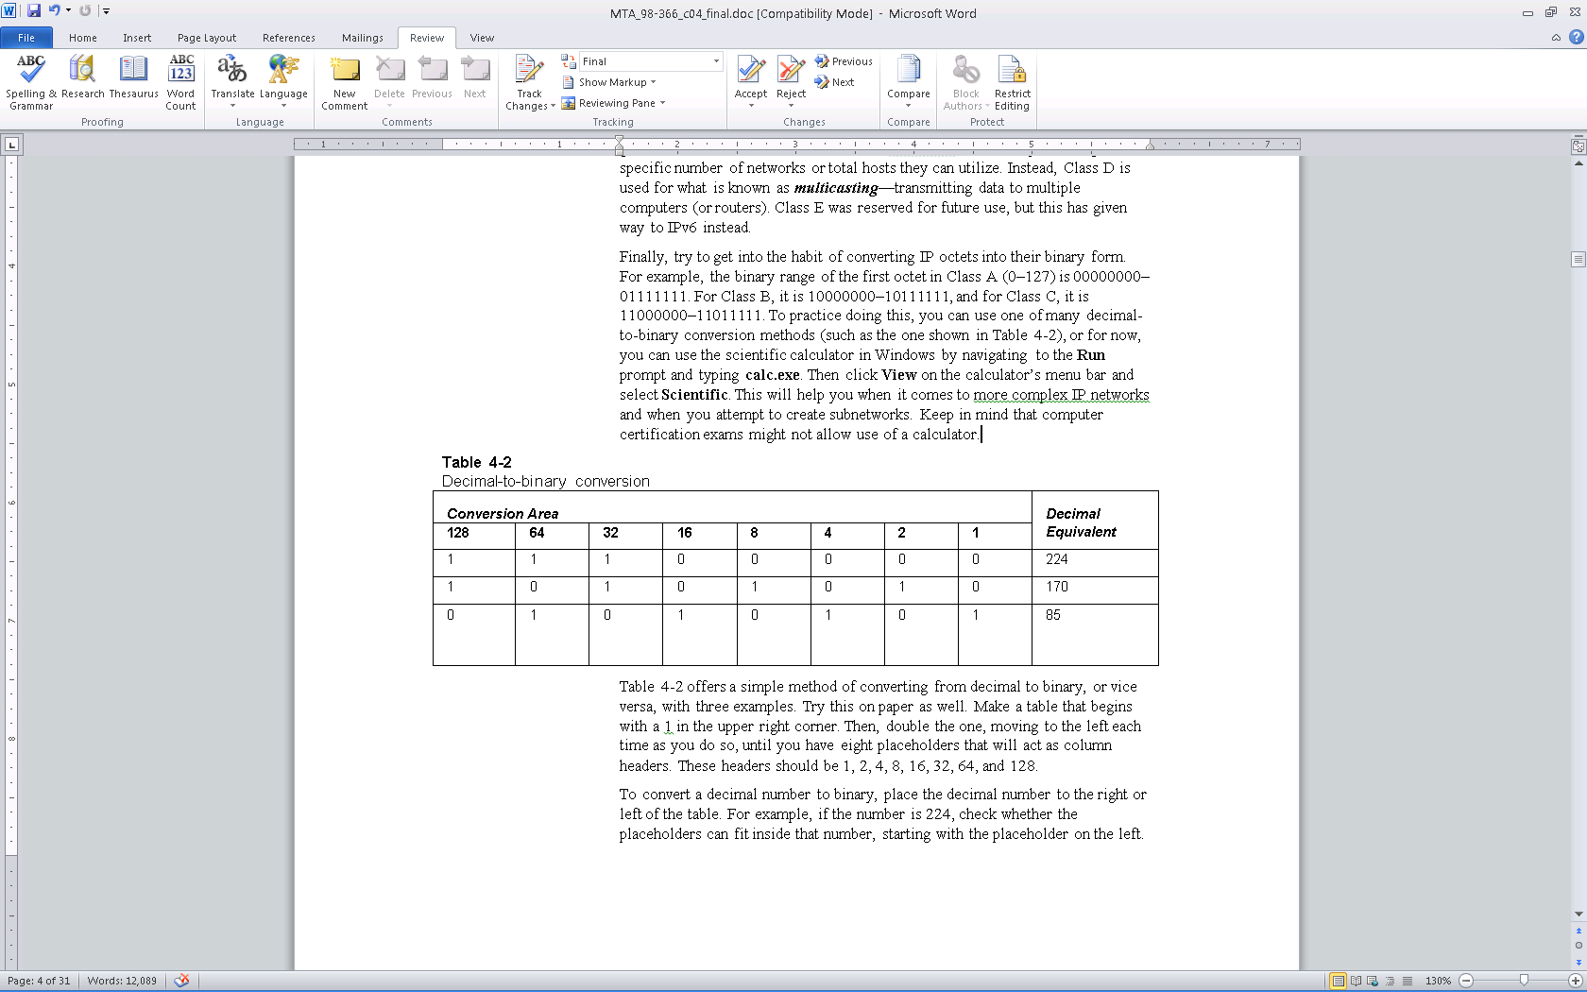
Decimal to Binary

Slide 12
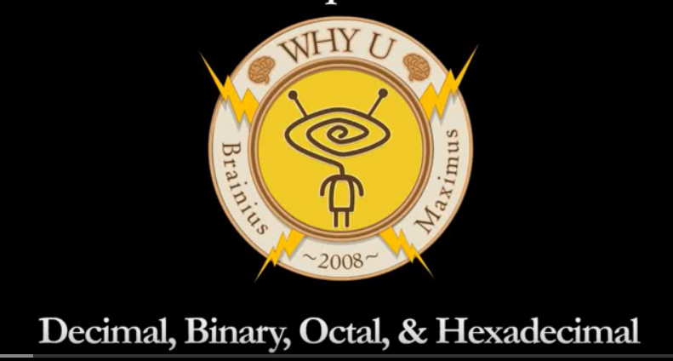
Lesson 4 Videos - Decimal, Binary, Octal Hexadecimal
Or https://youtu.be/5sS7w-CMHkU

Slide 13
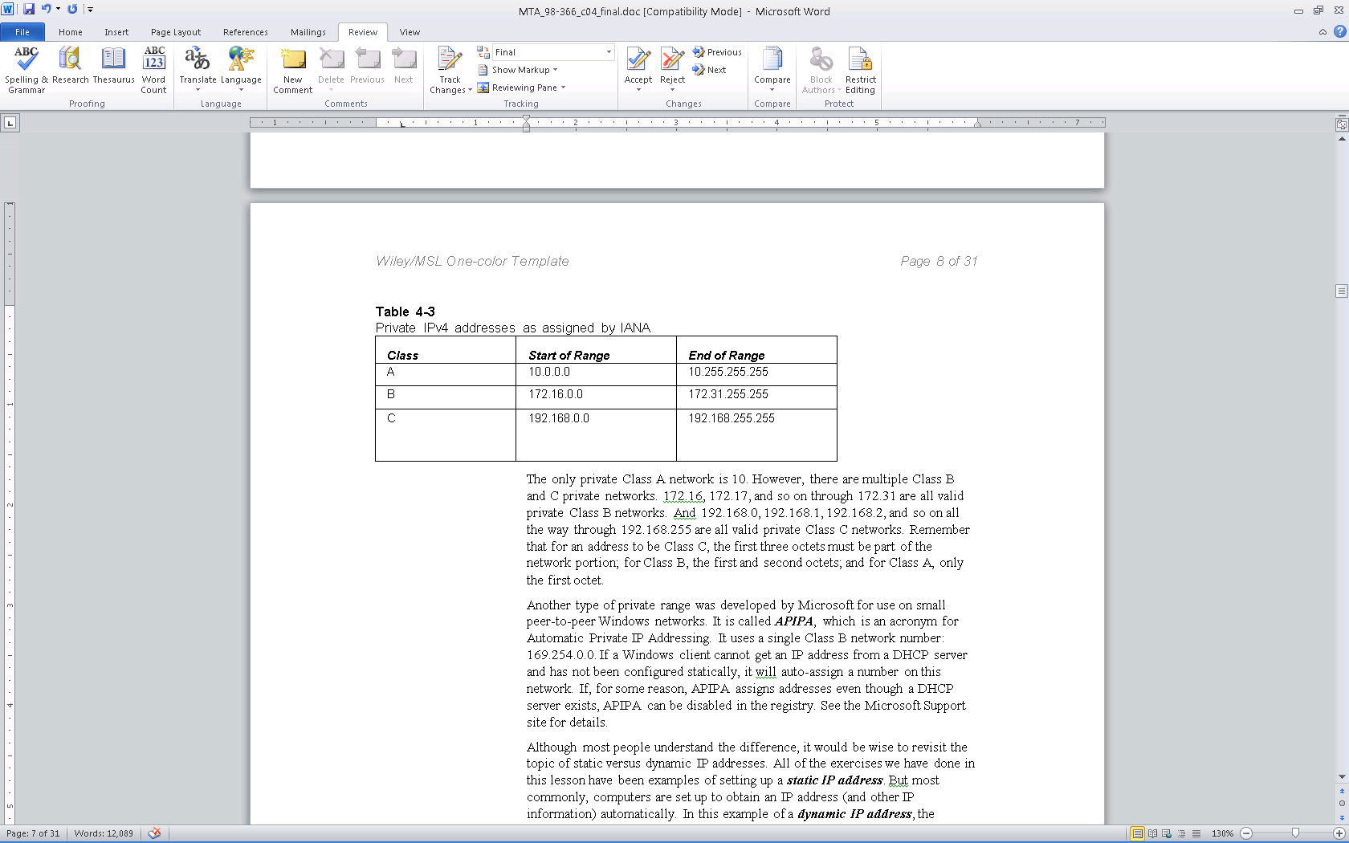
Public IP addresses are ones that are exposed to the Internet
Private IP addresses are hidden from the Internet and any other networks.
Private Addresses:
Notes:
Public IP addresses are ones that are exposed to the Internet
Any other computers on the Internet can potentially communicate with them.
Private IP addresses are hidden from the Internet and any other networks.
They are usually behind an IP proxy or firewall device.

Slide 14
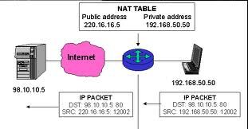
NAT, Private Networks

Slide 15
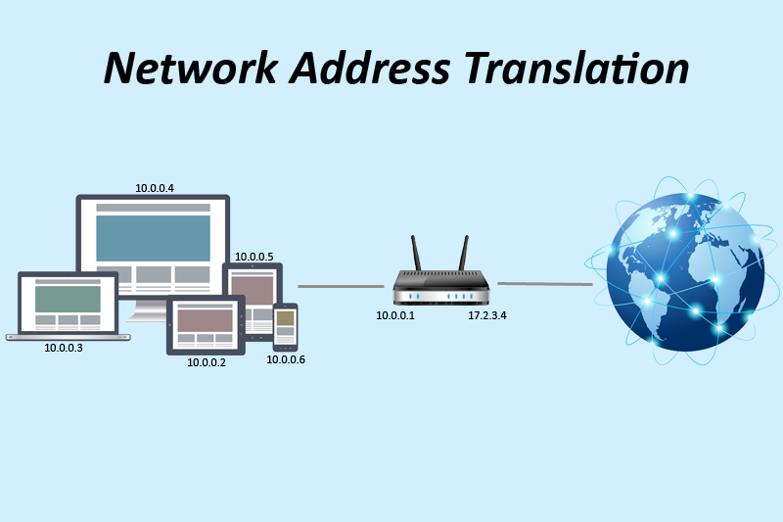
NAT – How Network Address Translation Works Video

Slide 16
APIPA
Automatic Private IP Addressing.
It uses a single Class B network number: 169.254.0.0.
If a Windows client cannot get an IP address from a DHCP server and has not been configured statically, it will auto-assign a number on this network.
Notes:
Has an address but still can’t talk to anyone
No internet, no router, peer to peer network. It will send requests and assigne hosts.

Slide 17
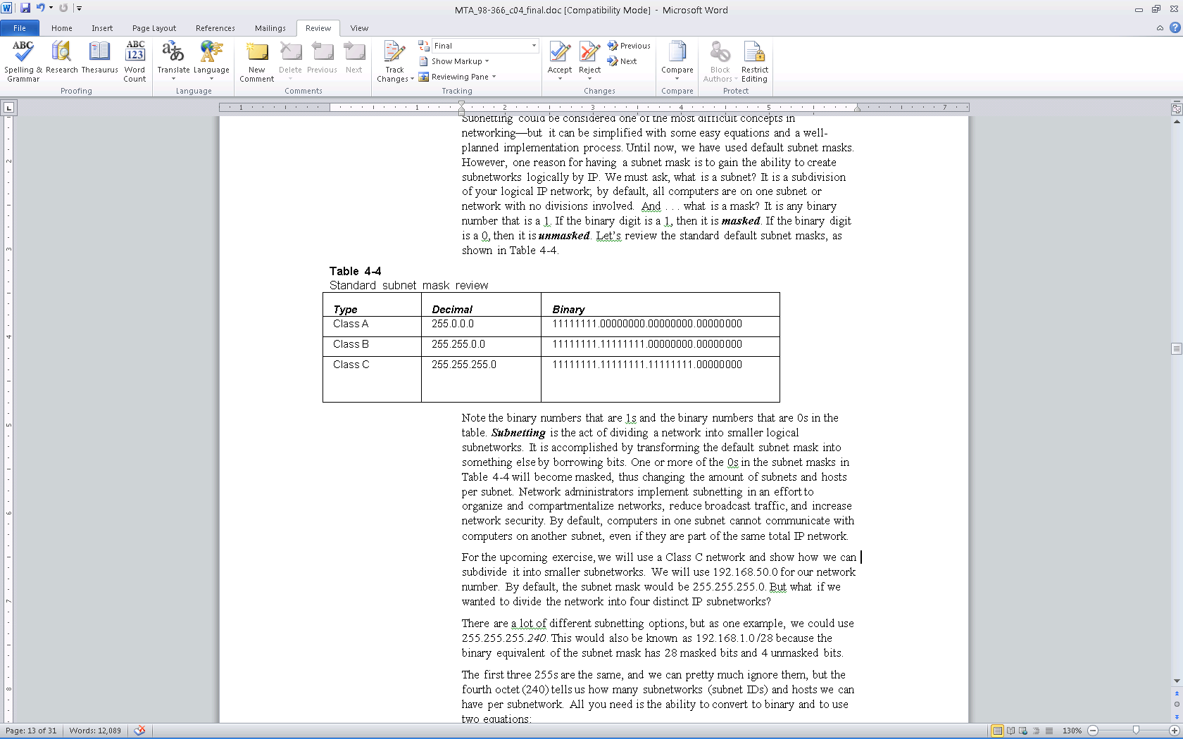
Subnetting
Subnetting is the subdivision of your logical IP network
By default, all computers are on one subnet or network with no divisions involved.
My modifying the default subnet mask, you can subnet your network into multiple smaller networks.

Slide 18
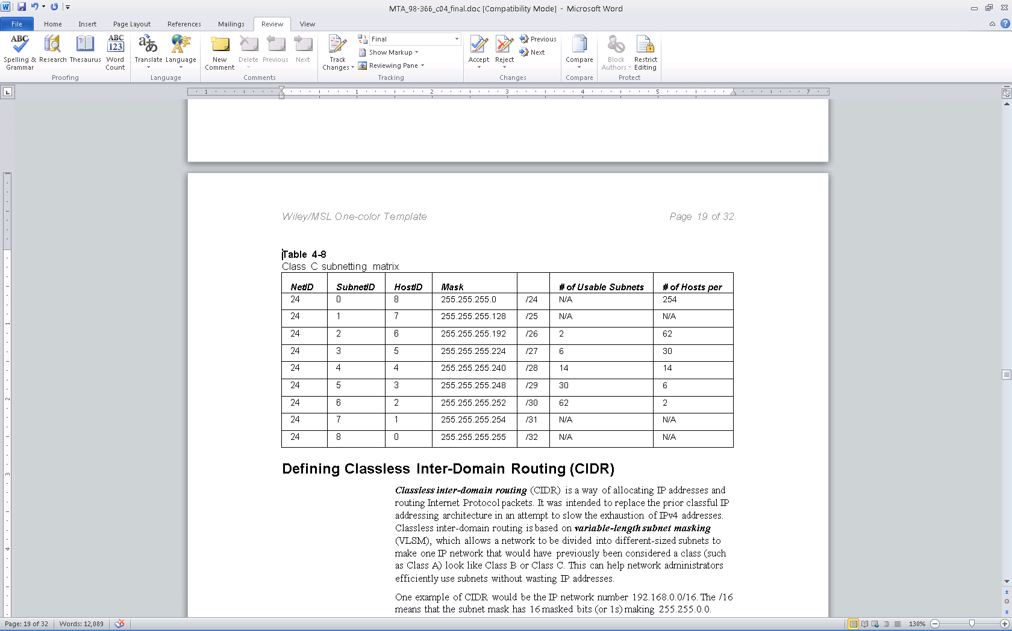
Notes:
Software method to create smaller networks.
Subnet ID borrows from NetID to give Host IDs

Slide 19
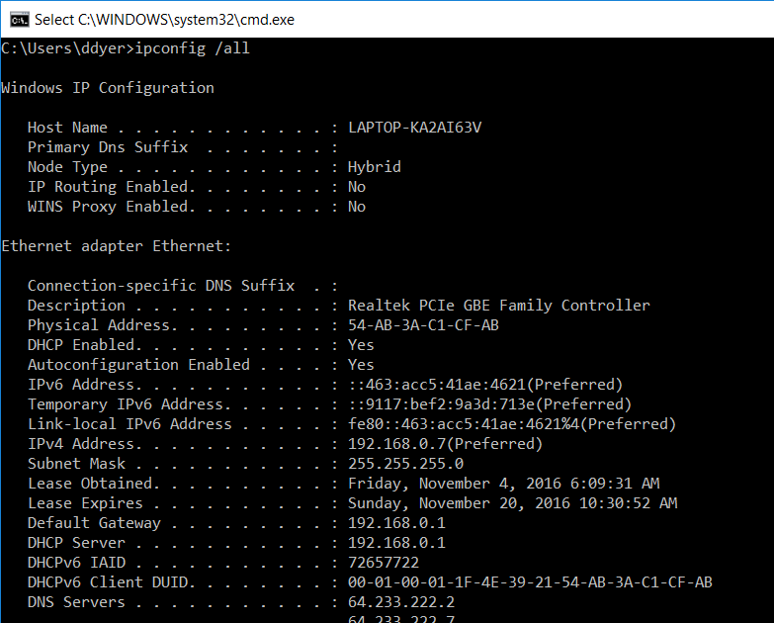

Slide 20
IPV 6
IPv6 uses a 128-bit address
IPv6 addresses consist of eight groups of four hexadecimal digits separated by colons, for example:
2001:0db8:85a3:0042:1000:8a2e:0370:7334
340,282,366,920,938,463,463,374,607,431,768,211,456,
or enough to give multiple IP addresses to every grain of sand on the planet.
Interoperable with IPV4
World Launch, 6 June 2012

Slide 21
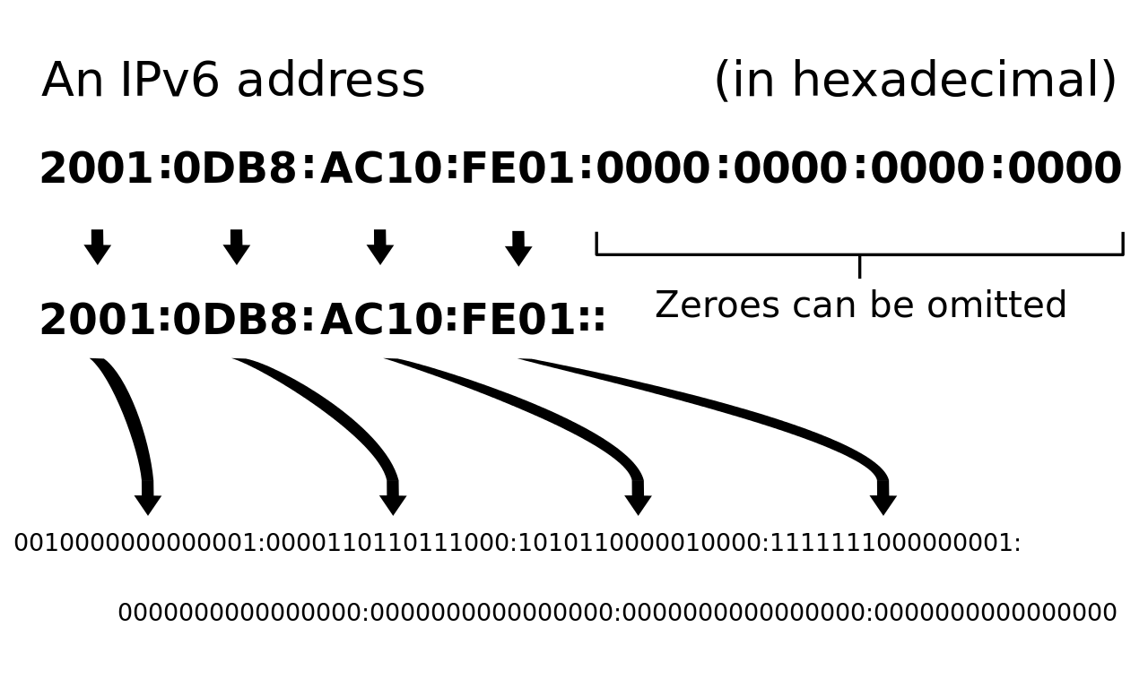
IPv6 - 8 groups of 4 hexadecimal digits
Allows for 340 undecillion addresses

Slide 22
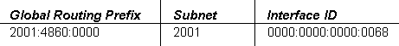
IPv6 addresses are broken down into three parts:
Global routing prefix: This is the first three groups of numbers, and it defines the “network” of the address.
IPv6 subnet: This defines the individual subnet of the network that the address is located on.
Interface ID: This is the individual host IP portion. It can be assigned to one interface or more than one interface, depending on the type of IPv6 address.
2001:4860:0000:2001:0000:0000:0000:0068

Slide 23
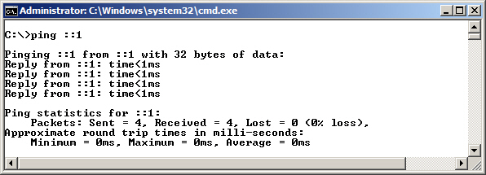
Testing IPv6 Loopback

Slide 24
Dual IP Stack
A dual IP stack exists when there are two Internet Protocol software implementations in an operating system, one for IPv4 and another for IPv6.
Dual stack IP hosts can run IPv4 and IPv6 independently, or they can use a hybrid implementation, which is the most commonly used method for modern operating systems.

Slide 25
IPv4-Mapped Addresses
IPv4-mapped addresses have the first 80 bits set to 0 (note the double colon), the next 16 set to 1 (shown as ffff), and the last 32 bits populated by the IPv4 address.
These addresses look like IPv6 addresses, other than the last 32 bits, which are written in the customary dot-decimal notation.
Pv4-mapped IPv6 address for the IPv4 address
10.254.254.1 = ::ffff:10.254.254.1

Slide 26
IPv4 to IPv6 Tunneling
IPv6 packets can be encapsulated inside IPv4 datagrams.
In Microsoft operating systems, this is generally done with the Teredo adapter, which is a virtual adapter or “pseudo-interface,” not a physical network adapter. An example of one of these addresses would be:
Fe80::5efe:10.0.0.2%2

Slide 27
Decimal | Hexadecimal
0 | 0
1 | 1
2 | 2
3 | 3
4 | 4
5 | 5
6 | 6
7 | 7
8 | 8
9 | 9
10 | A
11 | B
12 | C
13 | D
14 | E
15 | F
LAB Demo
8421 8421 8421 [Hexadecimal is 4 bits long]
2048 1024 512 256 128 64 32 16 8 4 2 1

